Slide 1
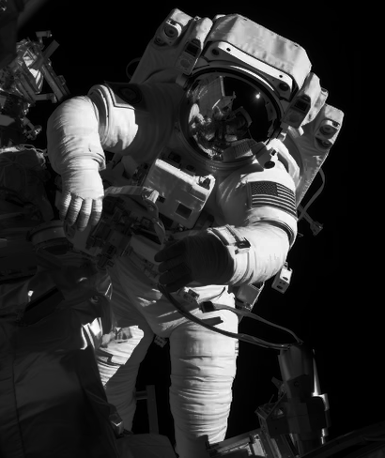
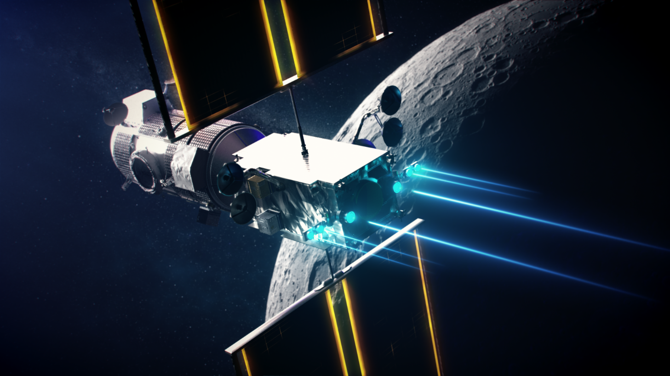
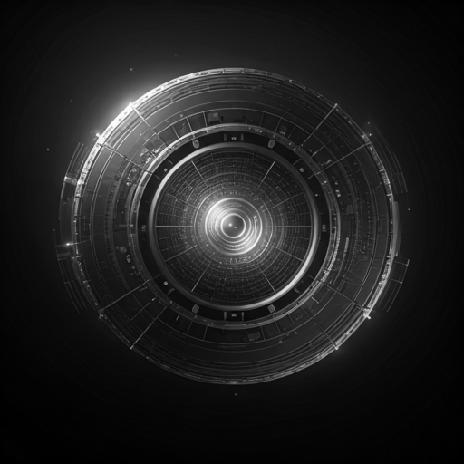
NASA Space Mission AI Project
Efficient Power Distribution through AI and Smart Grid Optimization
Group 8
Andrew Badzioch
Hillary Dreyer
Joseph Hiller
Quentin Smith

Slide 2
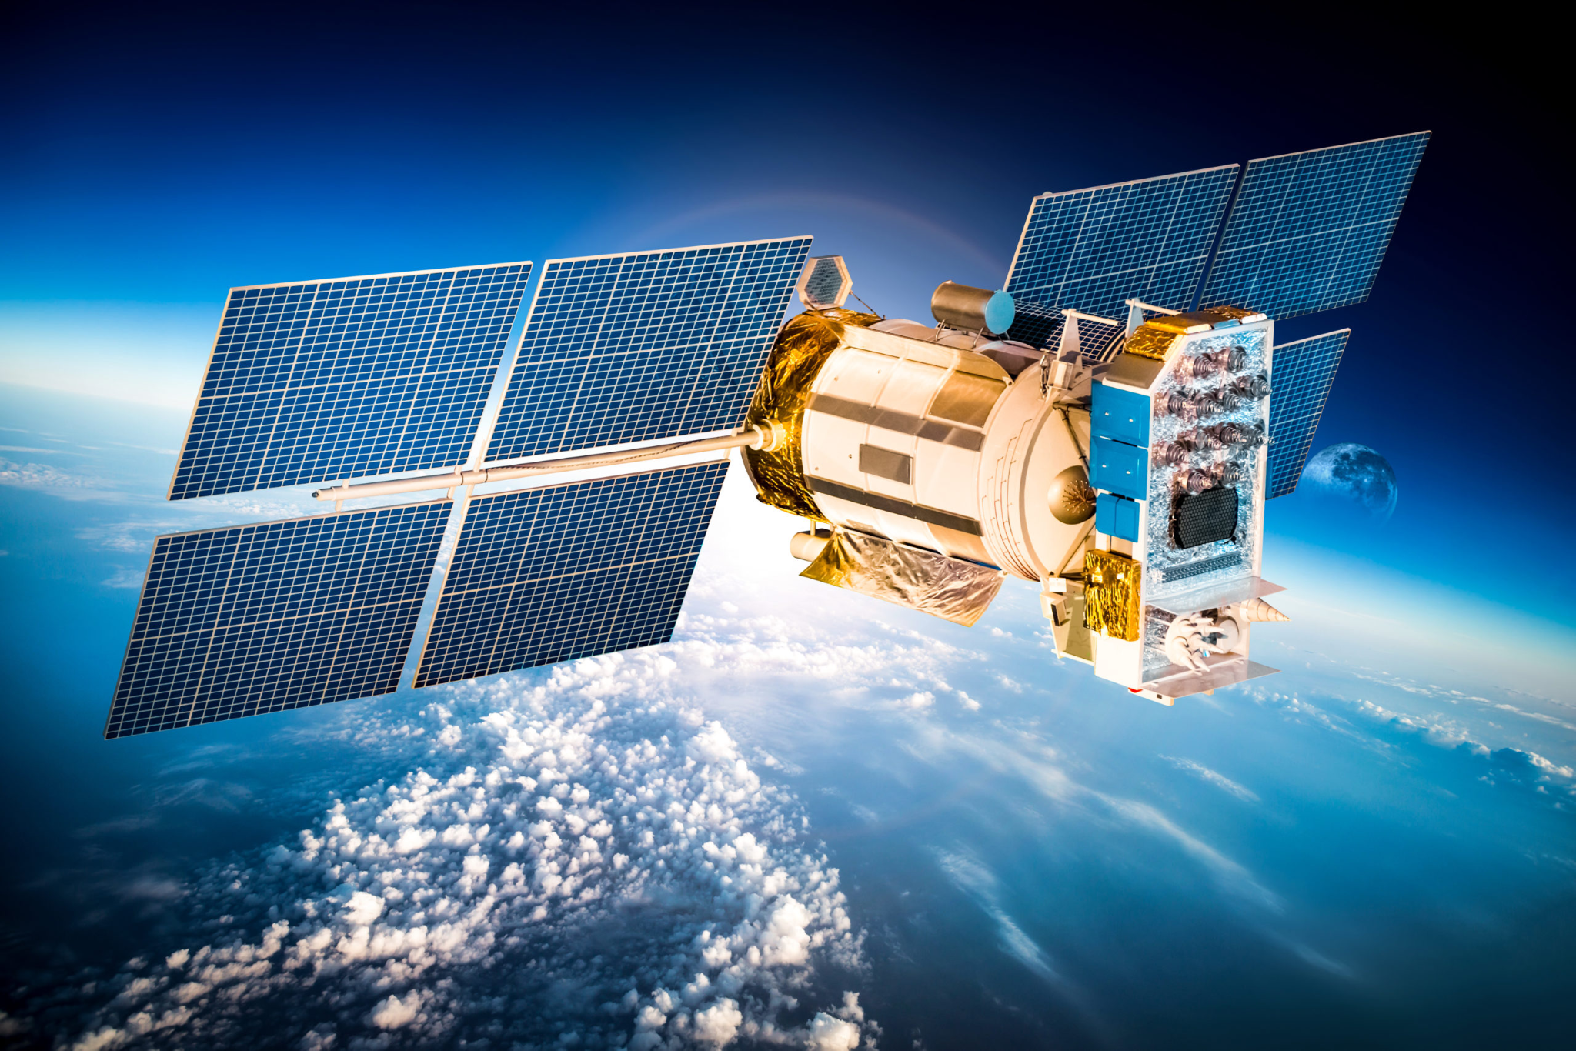
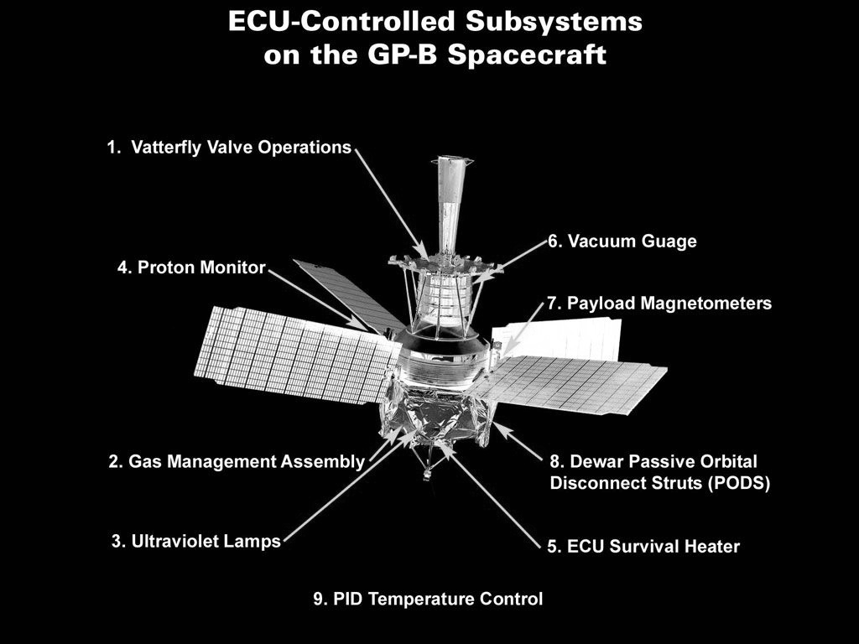
Context & Overview: Power Challenges in Space Exploration
Efficient Power Distribution in Space Missions
Space missions rely on limited energy sources.
Multiple subsystems compete for scarce power.
AI-driven solutions can optimize power distribution and improve system reliability.
Why Power Distribution is Critical in Space
Mission-critical operations depend on steady energy delivery.
Efficient use of energy reduces waste and extends mission lifespan.
Redundant solutions must address unforeseen failures.

Slide 3

Conceptual Project Objectives
Main Objectives
Prioritize energy allocation to mission-critical subsystems.
Minimize energy wastage by optimizing routing and usage.
Implement redundancies to counteract failures.
Balance the power demands of scientific instruments, life-support systems, propulsion, and communication.

Slide 4

Solution Plan Overview:
Establishing a smart AI-driven system for efficient and reliable power management.
Key Components of the Solution:
Smart Power Management Systems
AI-driven smart grids for real-time adjustments.
Redundant Power Architectures
Ensure backup solutions for critical operations.
Low Loss Power Transmission
Leverage superconductive technologies to reduce energy loss.

Slide 5
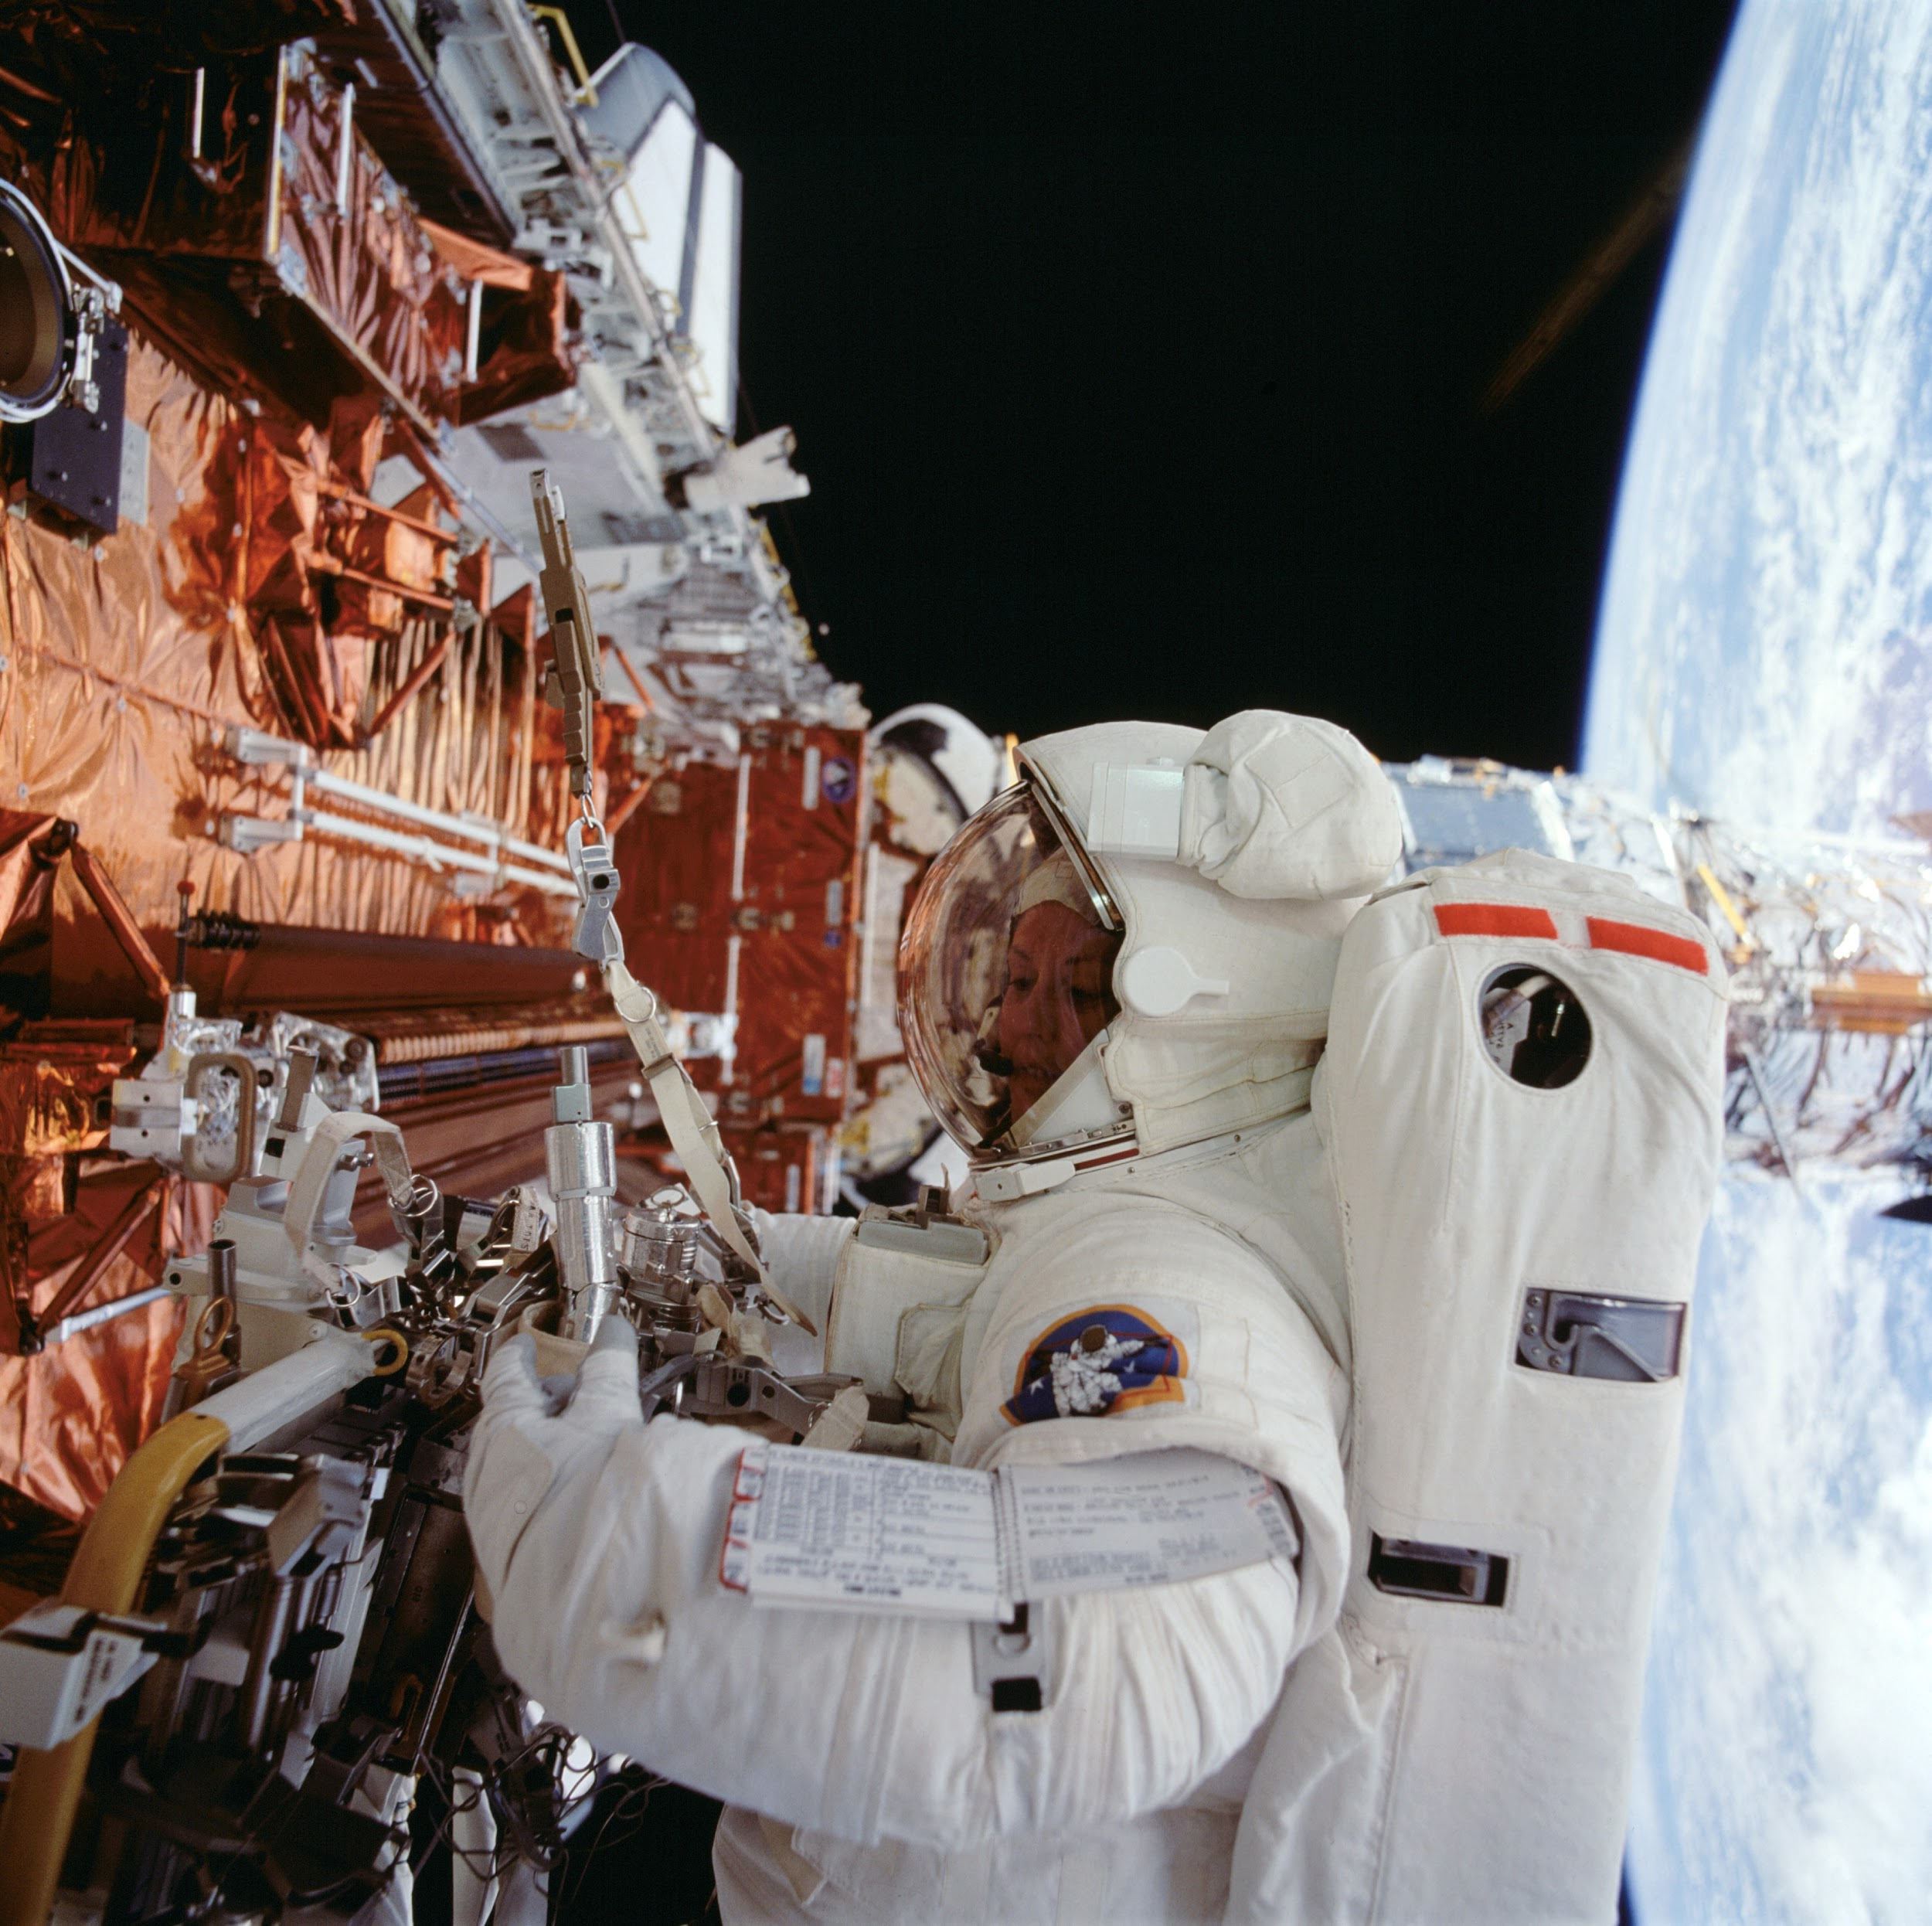
Components of the Solution

Slide 6

Smart Power Management Systems
Real-Time Monitoring & Prediction
Continuously track system power usage.
Predict future needs and adapt power routes dynamically.
Dynamic AI Allocation
Prioritize power distribution based on real-time subsystem needs.
Machine Learning Optimization
Learn usage patterns to minimize waste.
Autonomy in Decision-Making
Enable smart grids to function without Earth-based intervention in time-critical events.

Slide 7
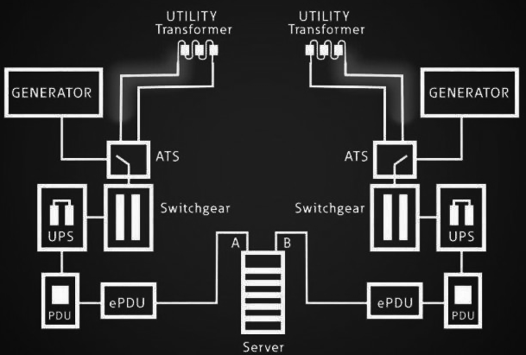
Redundant Power Architectures
Design Principles for Reliability
Implement backup systems to ensure continued operation during failures.
Examples of Redundancy:
Multiple power buses.
Backup batteries.
Dedicated battery systems for life support and navigation.
Fault Detection Systems
AI systems to identify failures in real-time and isolate them.

Slide 8
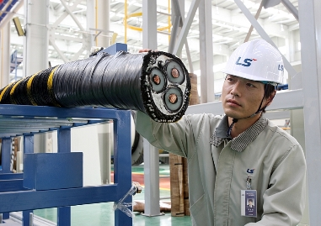
Low Loss Power Transmission
Utilize Advanced Materials
Superconductors with AI-optimized thermal management.
AI-Powered Diagnostics
Analyze sensor data to:
Detect inefficiencies in real time.
Predict system degradation.
Benefits
Stable voltage delivery.
Reduced energy waste.

Slide 9
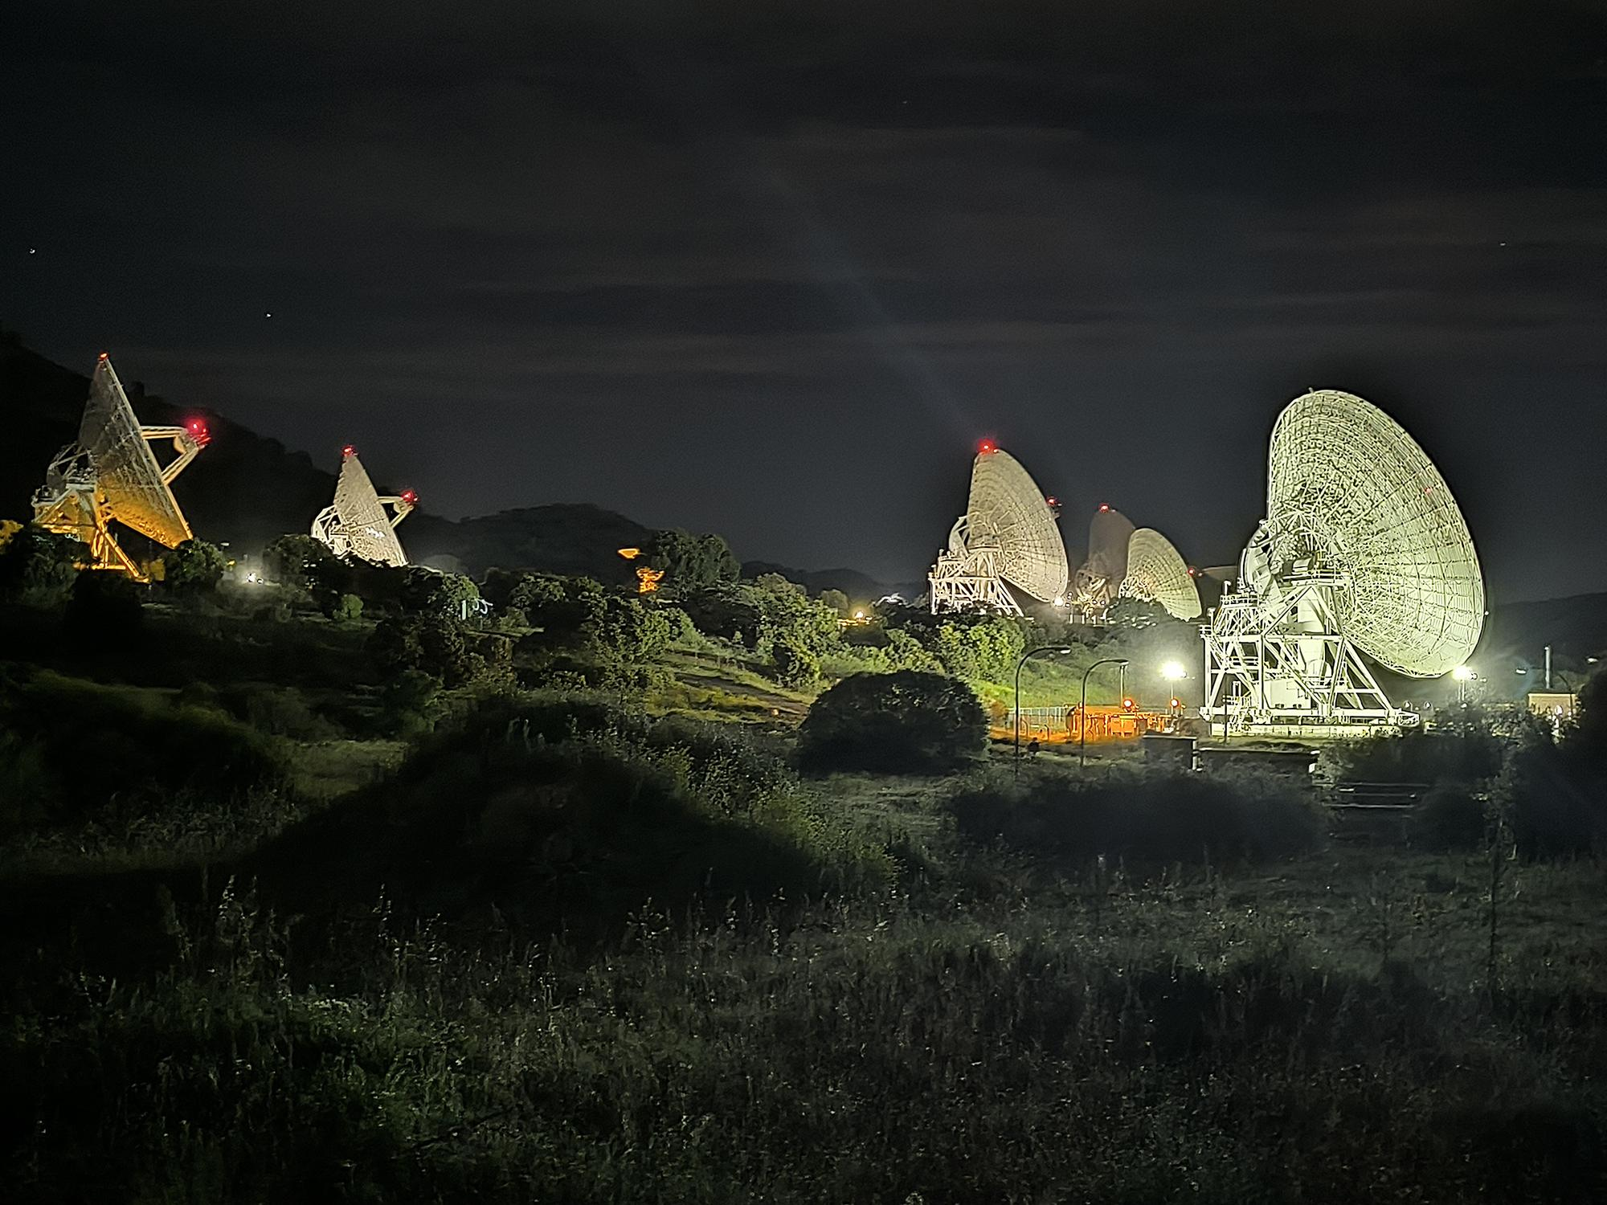
Solution plan Breakdown

Slide 10
Phase 1: Requirements Analysis
1
Evaluate Subsystem Power Needs:
Identify power requirements for key systems: scientific instruments, propulsion, life support, communication, thermal regulation, etc.
Analyze peak and average power demands under different mission scenarios (e.g., orbit, transit, landing).
Assess Environmental Challenges:
Plan for power fluctuations due to varying solar energy availability (e.g., planetary shadowing or dust storms).
Define Mission Priorities:
Establish a hierarchy of systems to determine energy allocation during power shortages.

Slide 11
Phase 2: System Design
2
Power Distribution Units (PDUs):
Develop modular PDUs to control power flow to subsystems.
Include fault detection and isolation capabilities to prevent cascading failures.
Intelligent Power Controllers:
Use AI-enabled controllers that monitor real-time energy demand and availability.
Implement algorithms for load balancing and adaptive power scaling based on subsystem priority.
Redundancy Mechanisms:
Design dual or triple redundant power buses to ensure reliability.
Integrate swappable power modules for in-space repairs.

Slide 12
Phase 3: Power Allocation Algorithms
3
Develop software solutions to efficiently distribute power:
Priority-Based Allocation:
Assign each subsystem a priority level (e.g., life support: critical, cameras: non-critical).
Automatically cut power to non-essential systems during shortages.
Dynamic Load Balancing:
Adjust power routing dynamically based on real-time conditions (e.g., reducing power to heaters during solar exposure).
Predictive Energy Management:
Use machine learning models to predict energy needs based on historical data and operational schedules.
Schedule energy-intensive tasks (e.g., data transmission) during periods of peak power availability.

Slide 13
Phase 4: Testing and Validation
4
Simulate Mission Scenarios:
Test power distribution systems under various conditions, such as:
Peak load operations.
Solar panel degradation.
Emergency scenarios (e.g., subsystem failures or unexpected power demands).
Stress Testing:
Push the power system to its limits to identify vulnerabilities.
Ensure fail-safes activate as intended.
Field Testing:
Test the system in analog environments, such as Mars analog sites or thermal vacuum chambers.

Slide 14
Phase 5: Deployment and Monitoring
5
Integration with Spacecraft:
Install and test the system on the spacecraft before launch.
Calibrate power distribution for the spacecraft's final configuration.
Real-Time Monitoring:
Use telemetry systems to monitor power distribution during the mission.
Send updates to mission control for performance analysis and troubleshooting.
Autonomous Adjustments:
Enable the spacecraft to autonomously adapt to changes in power supply or demand, reducing reliance on Earth-based intervention.

Slide 15
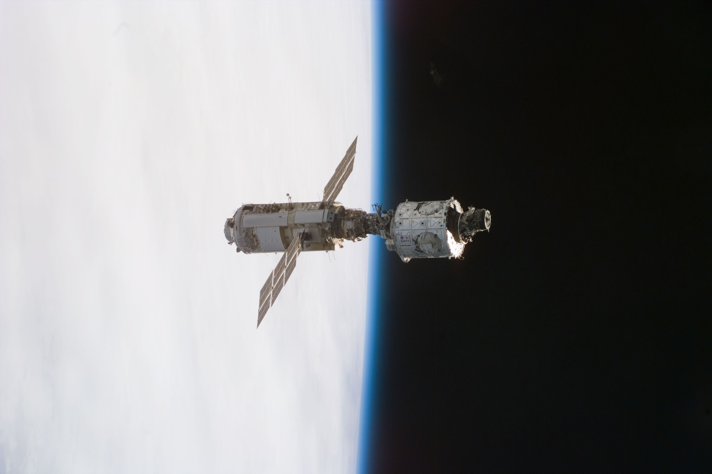
Advanced Features

Slide 16

Energy Harvesting
Incorporate technologies to recover and redistribute unused or wasted energy (e.g., thermoelectric generators to convert heat to electricity).
Power Storage Optimization
Pair distribution systems with high-capacity batteries or supercapacitors for seamless energy storage and discharge.
Cross-Subsystem Collaboration
Enable communication between subsystems to share energy usage data and optimize collective consumption.

Slide 17
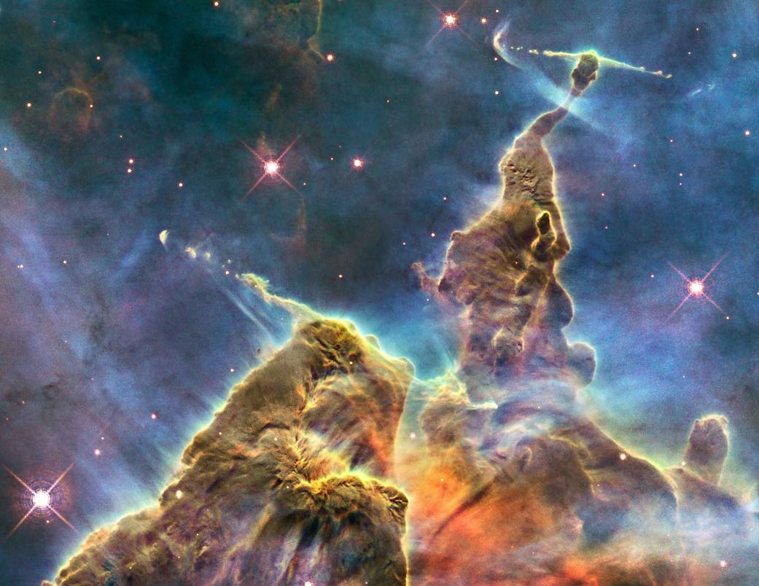
Benefits of the Plan

Slide 18
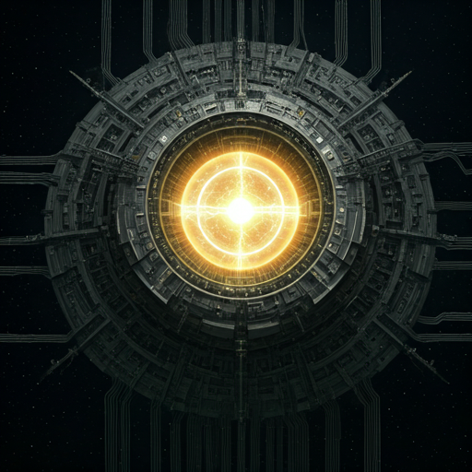
Reliability:
Ensures critical systems receive uninterrupted power, even during emergencies or system failures.
Efficiency:
Minimizes energy waste, extending mission duration and performance.
Scalability:
Can be adapted for different types of missions, from rovers to deep-space probes.
Autonomy:
Reduces dependence on Earth-based intervention for power management.

Slide 19
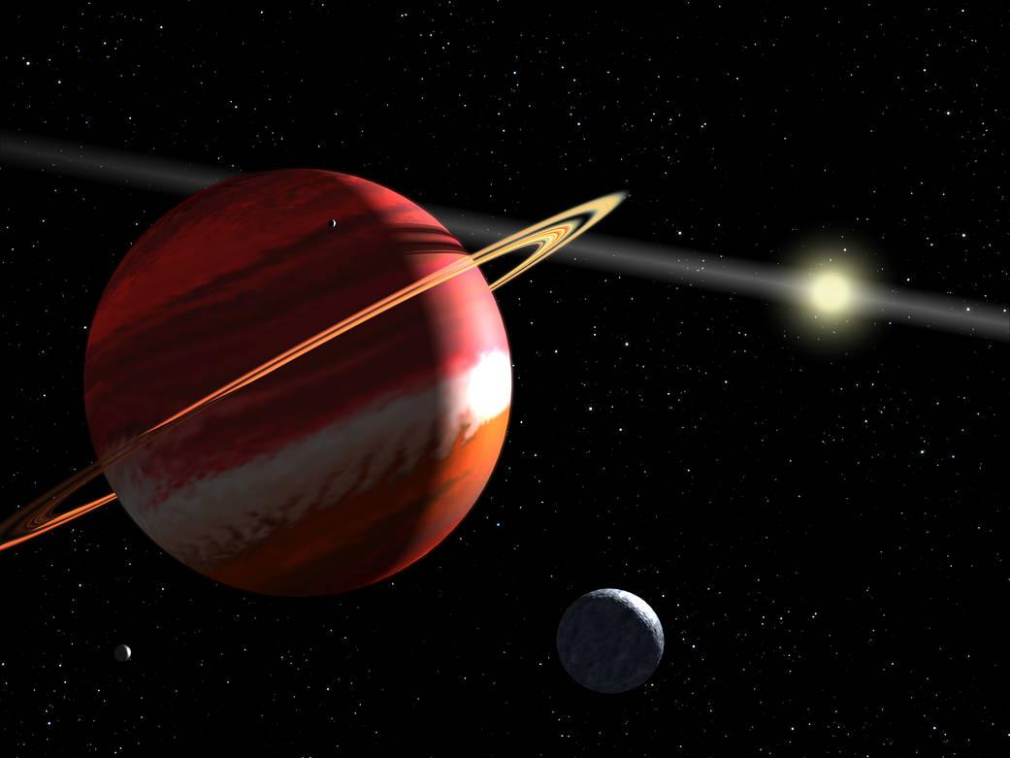
Potential Challenges and Mitigation

Slide 20

Challenge: Overcomplicated AI systems might introduce risks of errors.
Mitigation: Use hybrid systems where AI is supervised by predefined rules for critical operations.
Challenge: Redundancy adds mass to spacecraft.
Mitigation: Use lightweight materials and modular designs to minimize impact on payload capacity.
Challenge: Unknown conditions in deep space.
Mitigation: Include self-learning capabilities in AI to adapt to unexpected scenarios.

Slide 21
Conclusion
Implementing this solution plan will significantly enhance power distribution efficiency for NASA space missions. By leveraging advanced technologies such as AI, modular designs, and smart controllers, NASA can ensure reliable and optimized power delivery, paving the way for longer and more ambitious space explorations.

Slide 22
References
NASA. "Advanced Energy Storage and Management for Space Exploration." NASA Technical Reports Server (NTRS), 2023. Retrieved from https://ntrs.nasa.gov&#8203;:contentReference[oaicite:0]{index=0}.
NASA. "Modular Power Systems for Space Missions: Intelligent PMAD Functional Block Diagram." NASA Technical Reports Server (NTRS), 2023. Retrieved from https://ntrs.nasa.gov&#8203;:contentReference[oaicite:1]{index=1}.
National Renewable Energy Laboratory (NREL). "Space-Based Solar Power Research." NREL Publications, 2023. Retrieved from https://www.nrel.gov&#8203;:contentReference[oaicite:2]{index=2}&#8203;:contentReference[oaicite:3]{index=3}.

